Slide 1
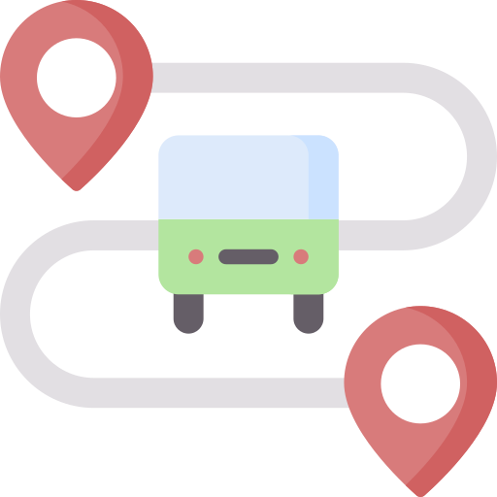
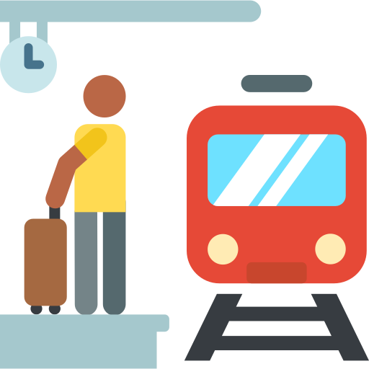
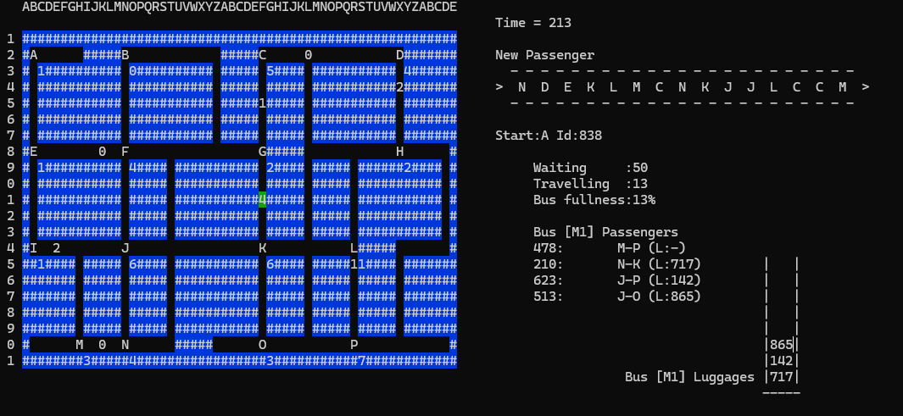

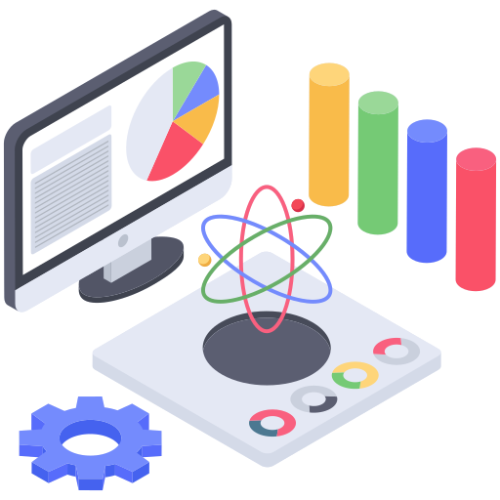
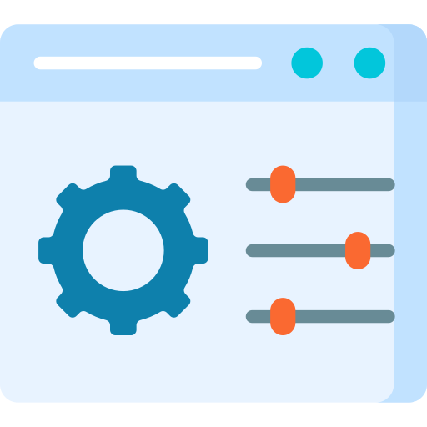
Big CITY
A bus-stop simulation
You can create your own system and test your bus-stop simulation, before doing any physical tests.
THE
What is the “big city”?
"Big City" is a comprehensive public transport simulation that models a 21x57 grid city, featuring building blocks, roads, and 16 bus stops.
The core of the simulation revolves around 6 distinct bus lines, each with 2 buses, transporting passengers with unique IDs and even luggage.
The application's aim is to simulate the city's public transport system and create statistics. This project provides a detailed and interactive look into urban transit dynamics.
What Can you do in the simulation ?
Observe Bus Operations
Watch buses autonomously navigate the city, pick up passengers, and manage luggage.
Monitor Passenger Flow
See how passengers are generated, queue at stops, and travel to their destinations.
Inspect Live Data
Click on any bus or bus stop to view its current passenger count, luggage details, and operational status.
Sample View of the Simulation Interface
Control Simulation Speed
Start, pause, or resume the simulation to observe events at your desired pace.

